Slide 1
IOT BASED ACCURATE THERMAL SCREENING AND ALERT FOR COVID SITUATION USING BEAGLEBONE

Slide 2
Content
Introduction
INTERFACING DIGITAL NON-CONTACT INFRARED THERMOMETER (MLX90614) WITH BEAGLEBONE BLACK
Sensor specifications
Connections

Slide 3
Cont..
Coding
Desired Output
Hardware Wiring
References

Slide 4
Introduction
Mlx90614 is a infrared based sensor, it measures the temperature based on infrared emitted by an object. It senses electromagnetic waves in the range about 700 nm to 14,000 nm.
The MLX90614 is a non-contact infrared thermometer with a measurement range from -70 to +380 degree Celsius

Slide 5
Cont…..
Just connect the four leads to your Beagle bone and you will have an accurate thermometer with a resolution of 0.01 and an accuracy of 0.5 degrees, or for that matter you can use any microcontroller that can communicate with it through it’s I2C interface.

Slide 6
Sensor specifications
Small size, low cost
Mounted on a breakout board with two types of pins
10k Pull up resistors for the I2C interface with optional solder jumpers

Slide 7
Cont….
Factory calibrated in wide temperature range:
-40 … + 125 ° C for sensor temperature and
-70 … + 380 ° C for object temperature

Slide 8
Cont……
High accuracy of 0.5 ° C over wide temperature range (0 … + 50 ° C for both Ta and To) High (medical) accuracy calibration
Measurement resolution of 0.02 ° C
Single and dual zone versions

Slide 9
Cont….
SM Bus compatible digital interface
Customizable PWM output for continuous reading
Sleep mode for reduced power consumption

Slide 10
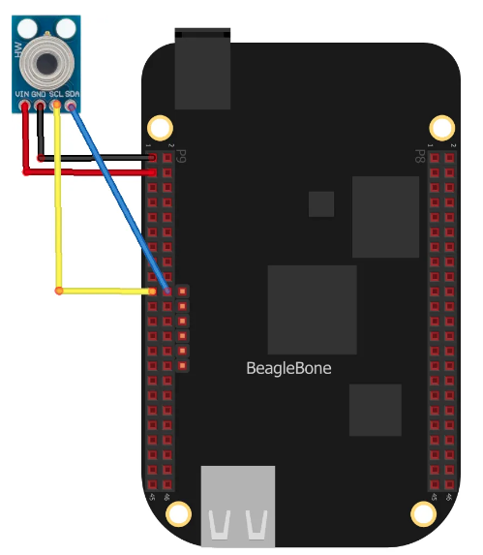
Hardware Wiring

Slide 11
Connections
MLX90614 module Connection | Beagle bone Connection
VIN | P9.3
Gnd | P9.1
SDA | P9.20
SCL | P9.19

Slide 12
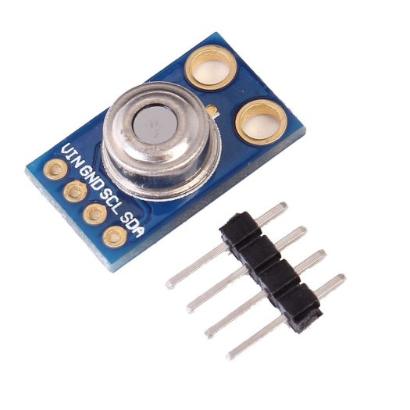
INTERFACING DIGITAL NON-CONTACT INFRARED THERMOMETER (MLX90614) WITH BEAGLEBONE BLACK
Being an I2C device you simply need to connect to the SDA, SCL and choose a suitable GND and Vin

Slide 13
Coding
#include <stdio.h>
#include <stdlib.h>
#include <linux/i2c-dev.h>
#include <sys/ioctl.h>
#include <fcntl.h>
#include <unistd.h>
#include <stdio.h> //Standard C input Output Library
#include <unistd.h> //defines miscellaneous symbolic constants and types, and declares miscellaneous functions
#include <string.h> //C Library for various String Operations
#include <termios.h> // Contains the definitions used by the terminal I/O interfaces
#include <sys/types.h> //definitions for types like size_t , ssize_t
#include <sys/stat.h> //header defines the structure of the data returned by the functions fstat(), lstat(), and stat(), give file size
#include <fcntl.h> // FIle control, Open, clos
#include <stdbool.h>

Slide 14
void main()
{
for(int k = 0; k < 5; k++)
{
// Create I2C bus
int file;
char *bus = "/dev/i2c-2";
char p1,p2,p3;
float temp_thermo;
bool ch;
usleep(10000);
file = open(bus, O_RDWR);
if(file < 0)
{
printf("Failed to open the bus. \n");
exit(1);
}

Slide 15
ioctl(file, I2C_SLAVE, 0x5A); //start I2C
//ch=i2c->write(i2caddress); //device address with write condition
char config[4] = {0};
config[0] = 0x5A;
config[1] = 0x07;
write(file, config, 2);
char data[7] = {0};
read(file, &data, 4);
for (int i =0; i<7; i++)
{
printf("Data1 %d \n",data[i]);
}
//i2c->start(); //repeat start
ioctl(file, I2C_SLAVE, 0x5A);
//ch=i2c->write(i2caddress|0x01); //device address with read condition
//No Ack, return False

Slide 16
config[0] = 0x5A|0x01;
write(file, config, 1);
//p1=i2c->read(1); //Tobj low byte
//p2=i2c->read(1); //Tobj heigh byte
//p3=i2c->read(0); //PEC
read(file, &data, 4);
//i2c->stop(); //stop condition
temp_thermo=((((data[1]&0x007f)<<8)+data[0])*0.02)-0.01; //degree centigrate conversion
temp_thermo=temp_thermo-273; //Convert kelvin to degree Celsius
for (int i =0; i<7; i++)
{
printf("Data %d \n",data[i]);
}
printf("Data Temp: %f \n",temp_thermo);
} }

Slide 17
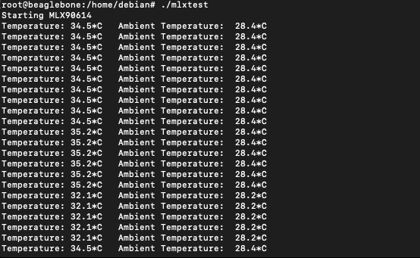
Desired output

Slide 18
References
Components101. (2020, March 31). MLX90614 Non-Contact IR Temperature Sensor Pin out, Datasheet, Equivalents & Specs. https://components101.com/sensors/melexis-mlx90614-contact-less-ir-temperature-sensor
BeagleBoard.org. (2019, September 6). BeagleBoard.org - black. Retrieved June 5, 2020, from https://beagleboard.org/black
M. D. Dramićanin, Z. Antić, S. Kuzman and T. Thundat, "Contactless temperature sensing via luminescence," 2016 18th International Conference on Transparent Optical Networks (ICTON), Trento, 2016, pp. 1-1, doi: 10.1109/ICTON.2016.7550592. https://ieeexplore.ieee.o

